Slide 1
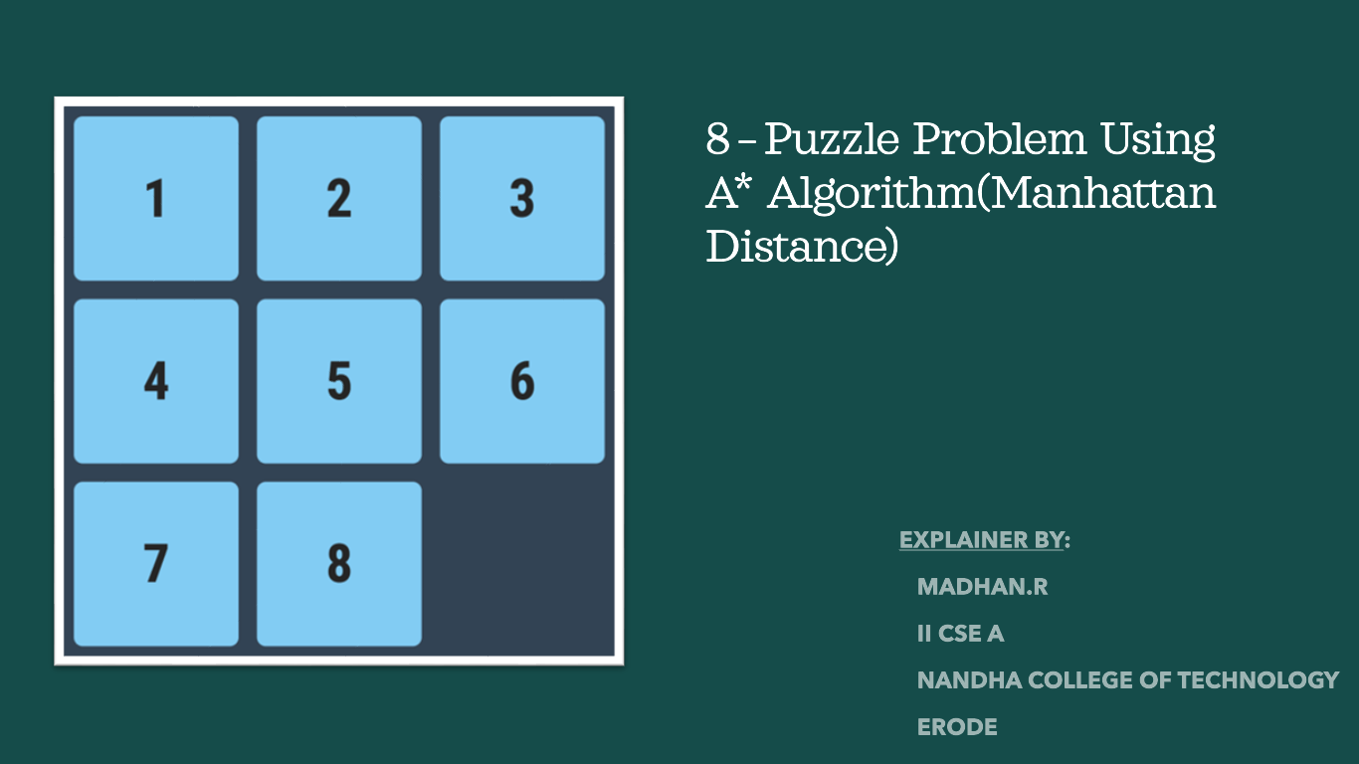

Slide 2
TOPIC:
EXAMPLE
WORKING MODEL
RULES
ALGORITHM

Slide 3
MANHATTAN DISTANCE ALGORITHAM:
The Manhattan distance is a distance metric used in machine learning and data science to measure the distance between two points in a coordinate system.
A lot of games and web-based maps use this algorithm for finding the shortest path efficiently.
It is also known as taxicab distance, city block distance, or L1 distance.

Slide 4
RULES FOR SOLVING THE PUZZLE
Instead of moving the tiles in the empty space, we can visualize moving the empty space in place of the tile, basically swapping the tile with the empty space. The empty space can only move in four directions viz.,
1. Up 2.Down 3. Right 4. Left
The empty space cannot move diagonally and can take only one step at a time (i.e. move the empty space one position at a time).

Slide 5
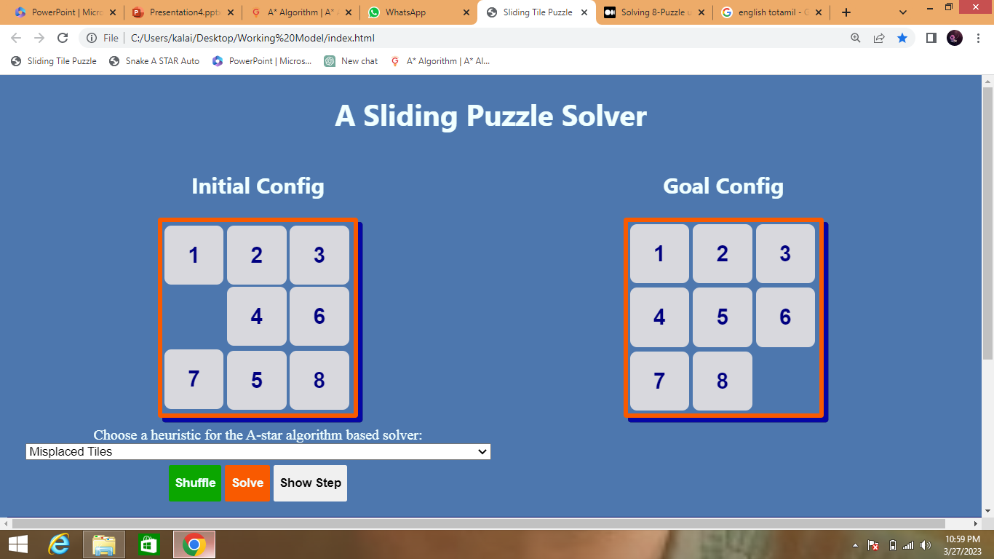
PRACTICE PROBLEMS BASED ON MANHATTAN ALGORITHM-
Given an initial state of a 8-puzzle problem and final state to be reached-
Find the most cost-effective path to reach the final state from initial state uusing Manhattan Algorithm.

Slide 6
SOLUTION:
Manhattan distance = |x_current - x_goal| + |y_current - y_goal|
Manhattan uses a combination of heuristic value is (x_current, y_current) is the current position of the tile and (x_goal, y_goal) is its goal position.
Manhattan Algorithm maintains a tree of paths originating at the initial state.
It extends those paths one edge at a time.
It continues until final state is reached.

Slide 7
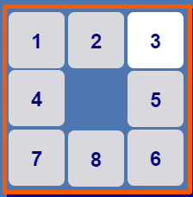
STEP 1 :
1 2 3
First consider the 5th tile
Current State = (2,3)
Goal State =(2,2)
Manhattan Distance= |2-2|+|3-2|
= 0+1
=1
1
2
3

Slide 8
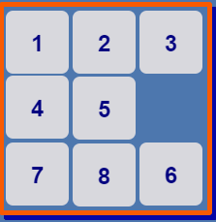
STEP 2 :
1 2 3
1
First consider the 6th tile
Current State = (3,3)
Goal State =(2,3)
Manhattan Distance= |3-2|+|3-3|
= 1+0
=1
2
3

Slide 9
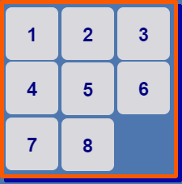
STEP 3 :
1 2 3
1
Goal State is Successfully Achieved.
2
3

Slide 10
WORKING MODEL:
The Manhattan distance heuristic is used not only for its simplicity but also for its ability to estimate the number of moves required to bring a given puzzle state to the solution state. Manhattan distance is simply computed by the sum of the distances of each tile from where it should belong.

Slide 11
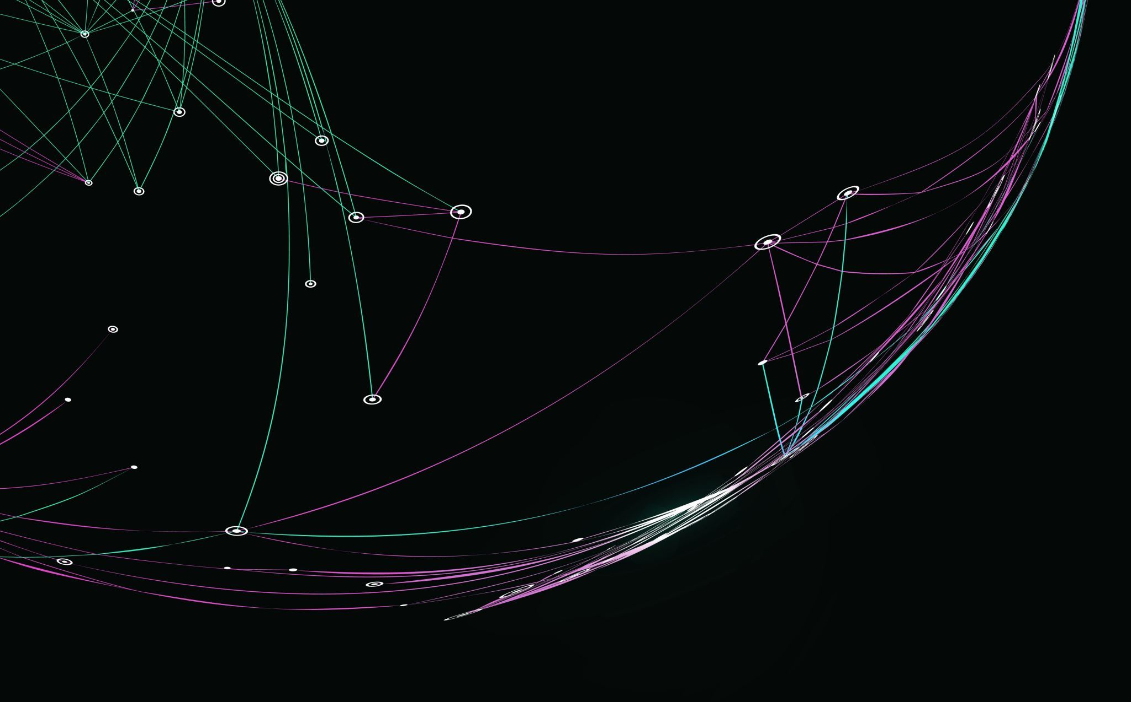
THANKING YOU

